Slide 1

CS 188: Artificial Intelligence
Neural Networks II
Instructor: Stuart Russell and Dawn Song
University of California, Berkeley
Notes:
Please retain proper attribution, including the reference to ai.berkeley.edu. Thanks!

Slide 2
Recap: Bayesian learning
Prior P(H), training data X=x₁,...,x_{N}
Given the data so far, each hypothesis has a posterior probability:
P(h_{k}|X) = α P(X|h_{k})P(h_{k}) = α x Likelihood x Prior
Predictions use a likelihood-weighted average over the hypotheses:
P(x_{N+1}|X) = Σ_{k} P(x_{N+1}|X,h_{k})P(h_{k}|X) = Σ_{k} P(x_{N+1}|h_{k})P(h_{k}|X)
No need to pick one best-guess hypothesis!
Drawback: Σ_{k} may be expensive/impossible for large/infinite H

Slide 3
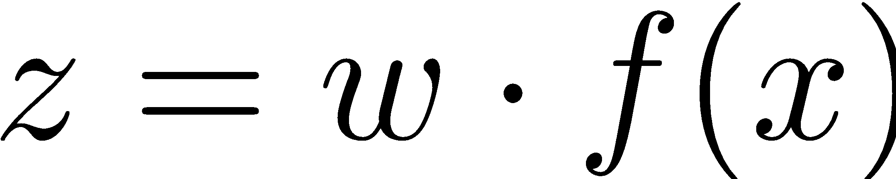
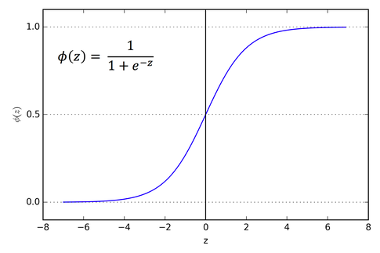
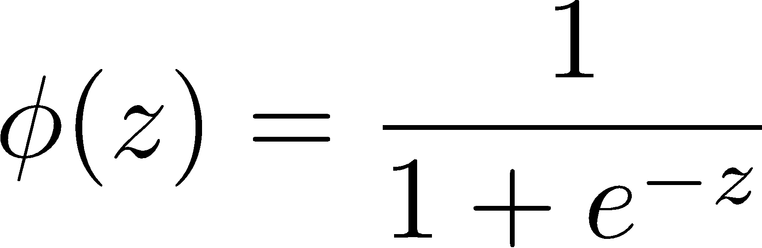
Recap: Logistic Regression
If very positive, then want probability going to 1
If very negative, then want probability going to 0
Sigmoid function

Slide 4
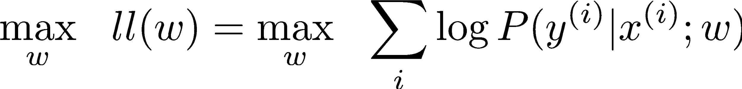
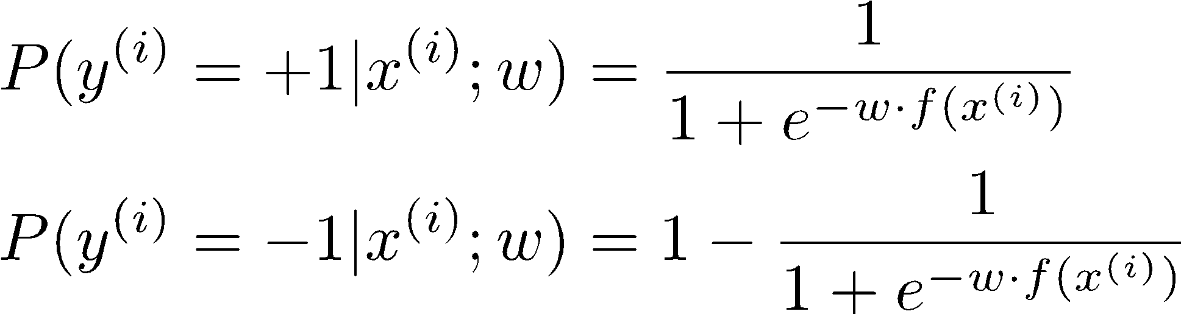
Recap: Maximum Likelihood Estimation for Logistic Regression
Maximum likelihood estimation:
with:

Slide 5
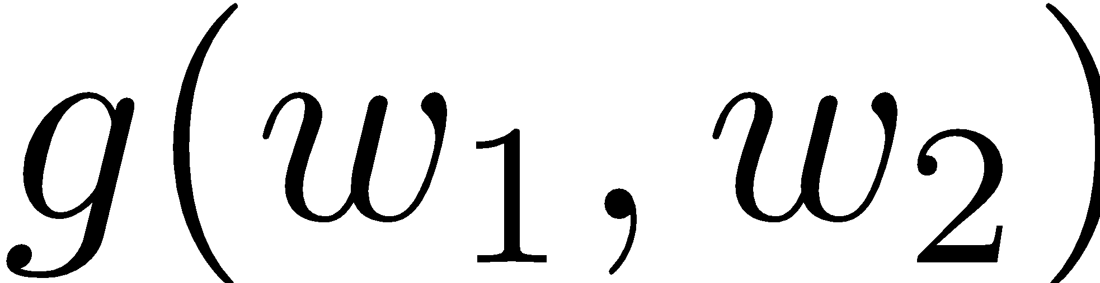
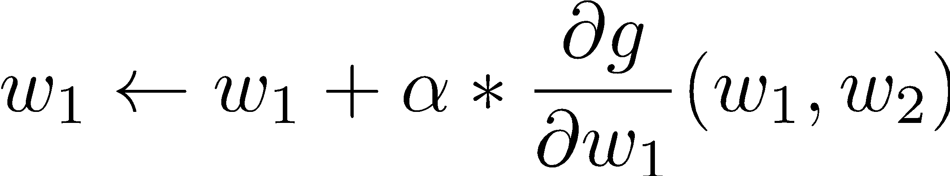
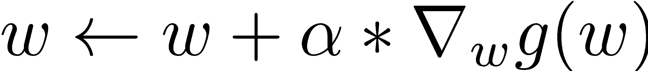
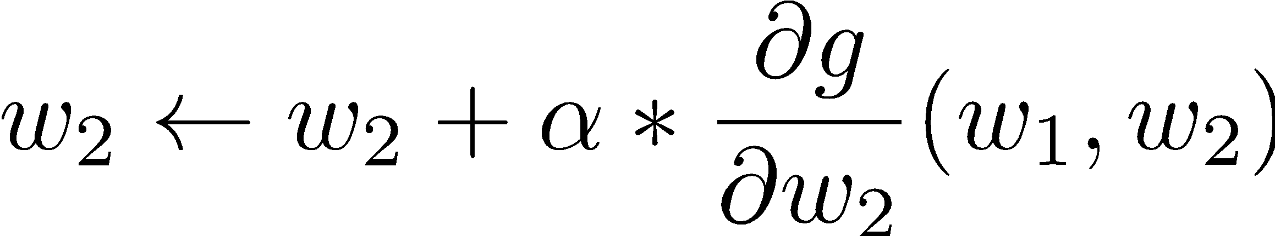
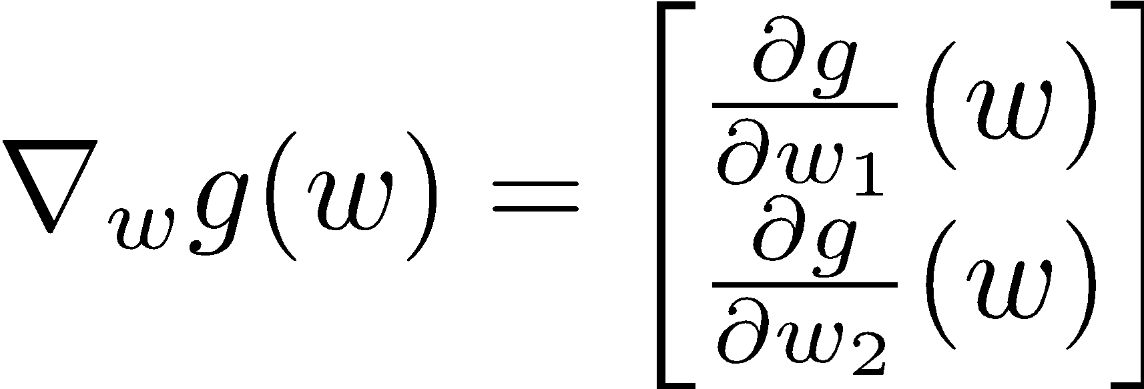
Recap: Gradient Ascent
Perform update in uphill direction for each coordinate
The steeper the slope (i.e. the higher the derivative) the bigger the step for that coordinate
E.g., consider:
Updates:
Updates in vector notation:
with:
= gradient

Slide 6
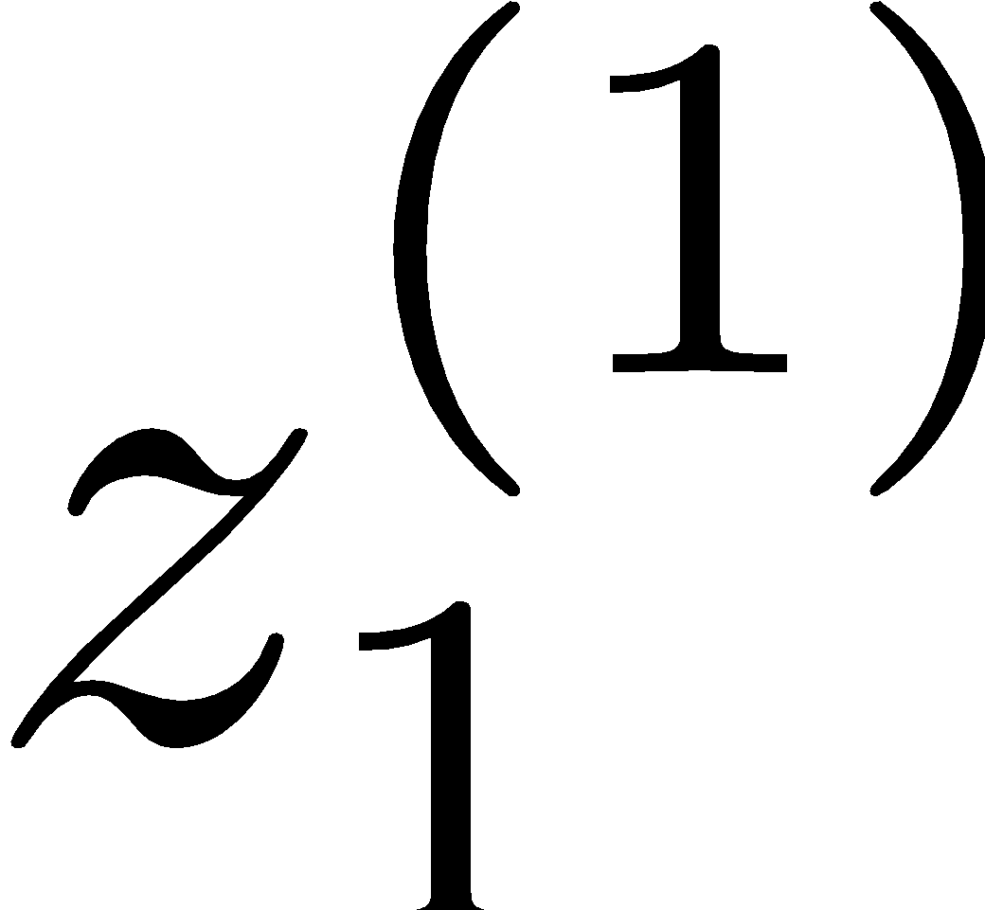
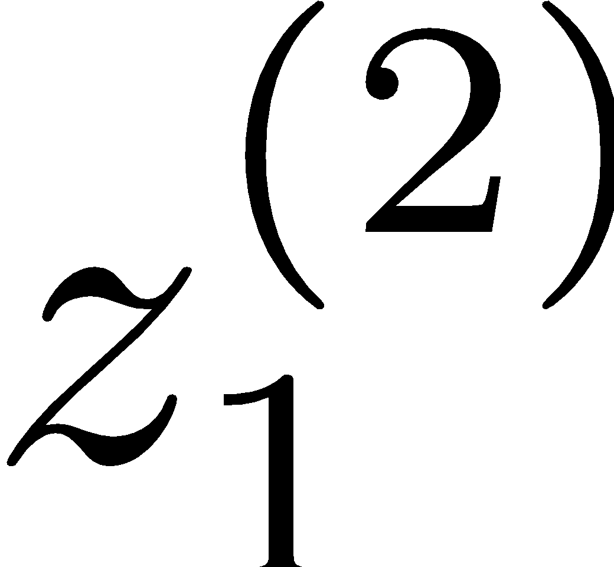
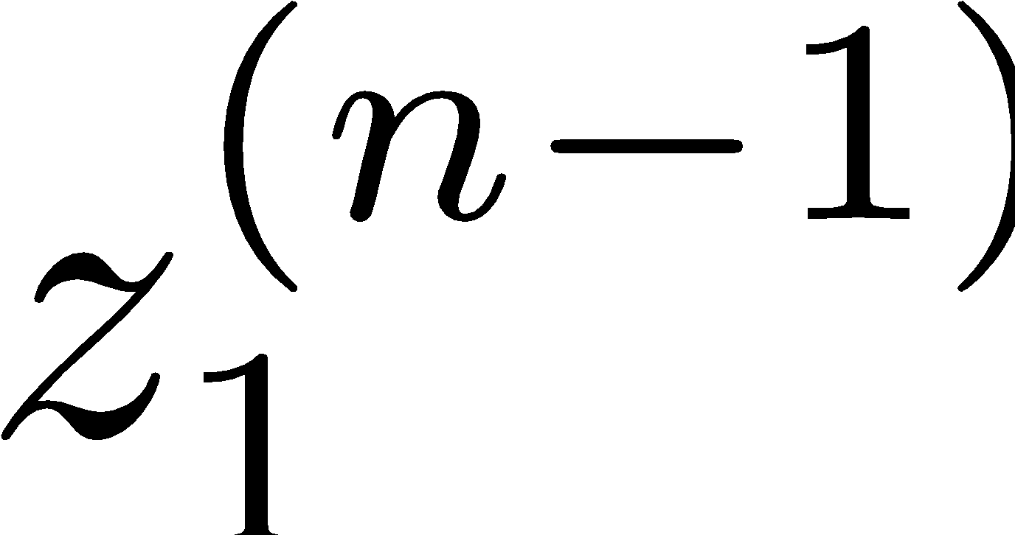
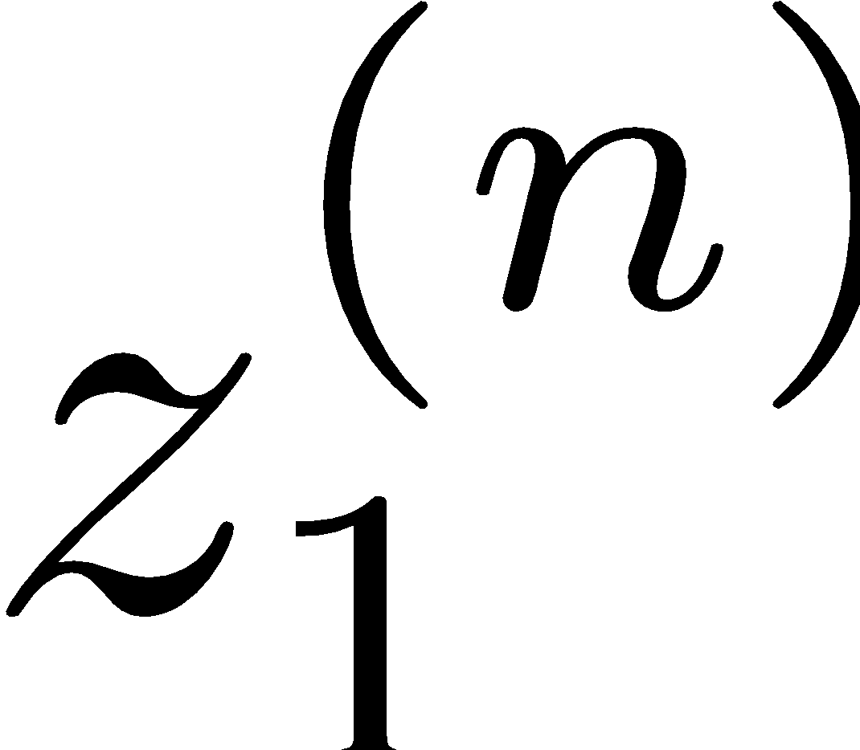
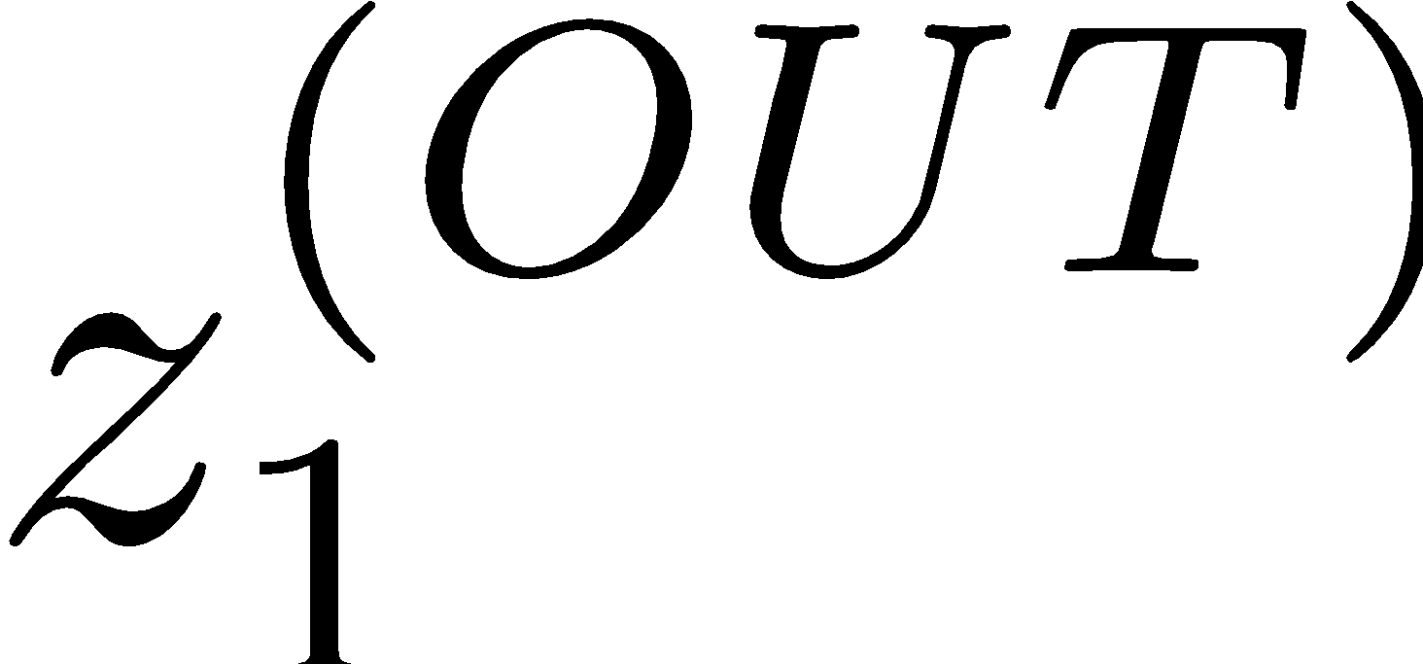
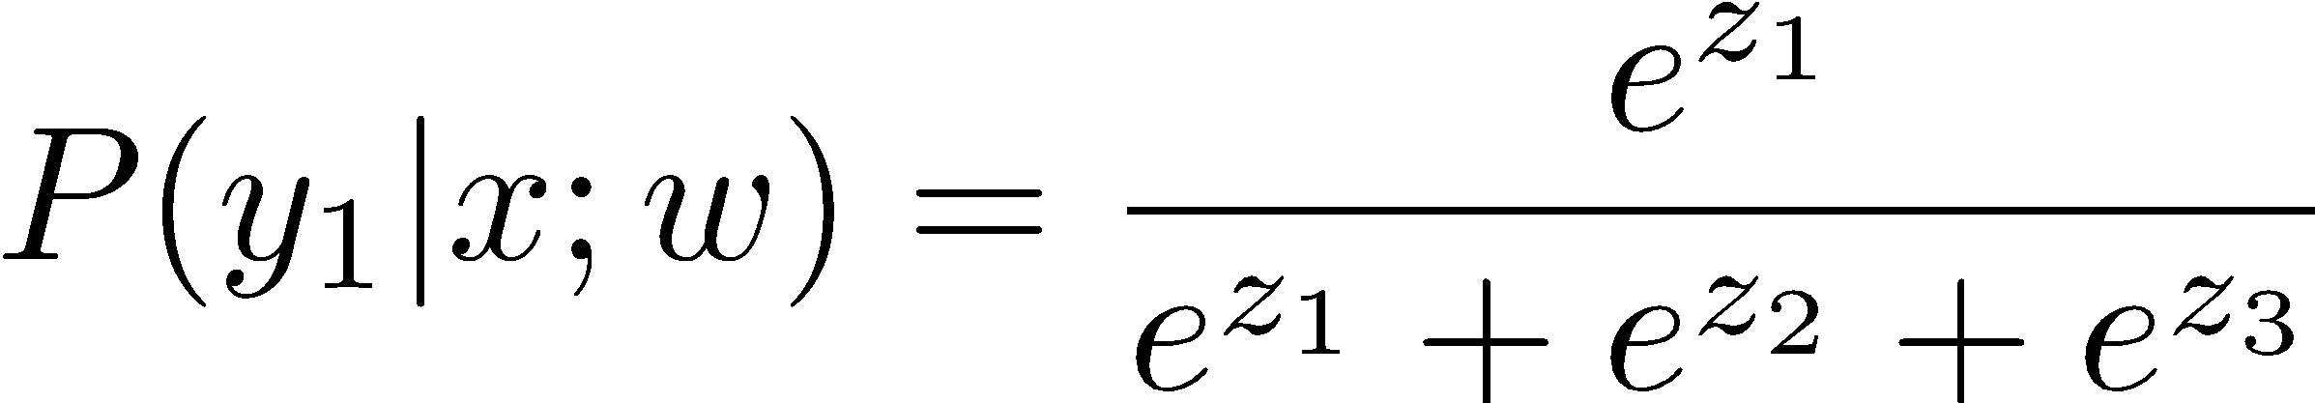
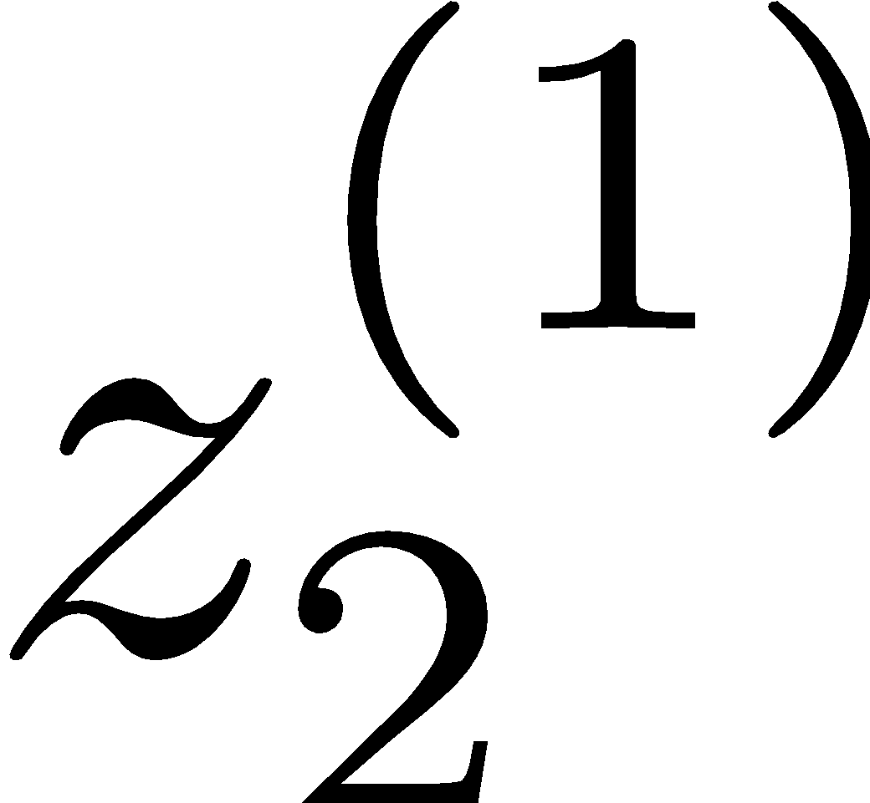
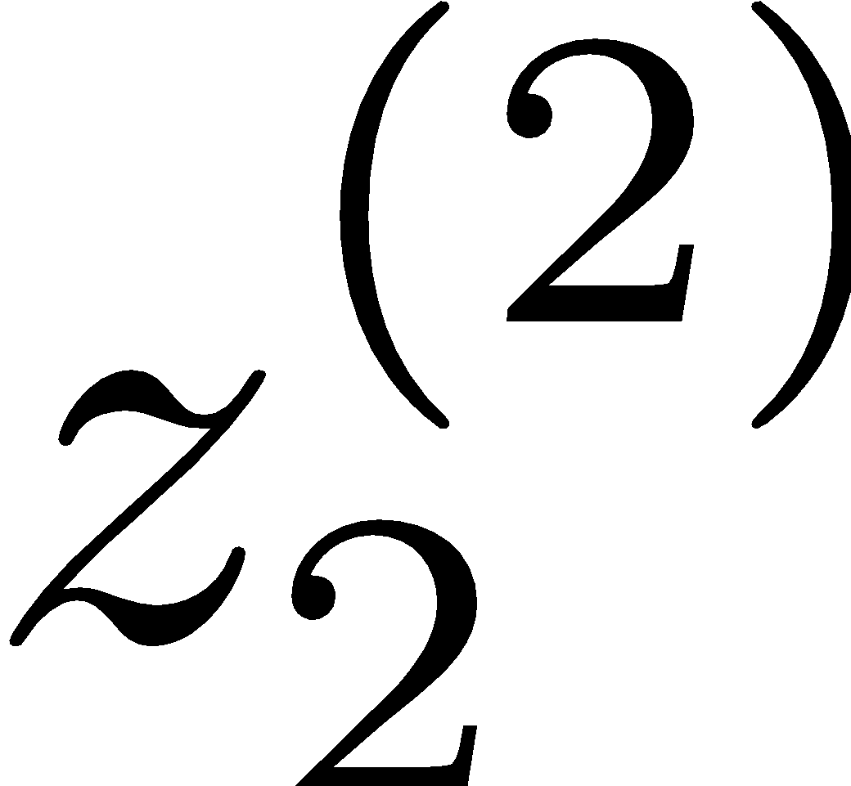
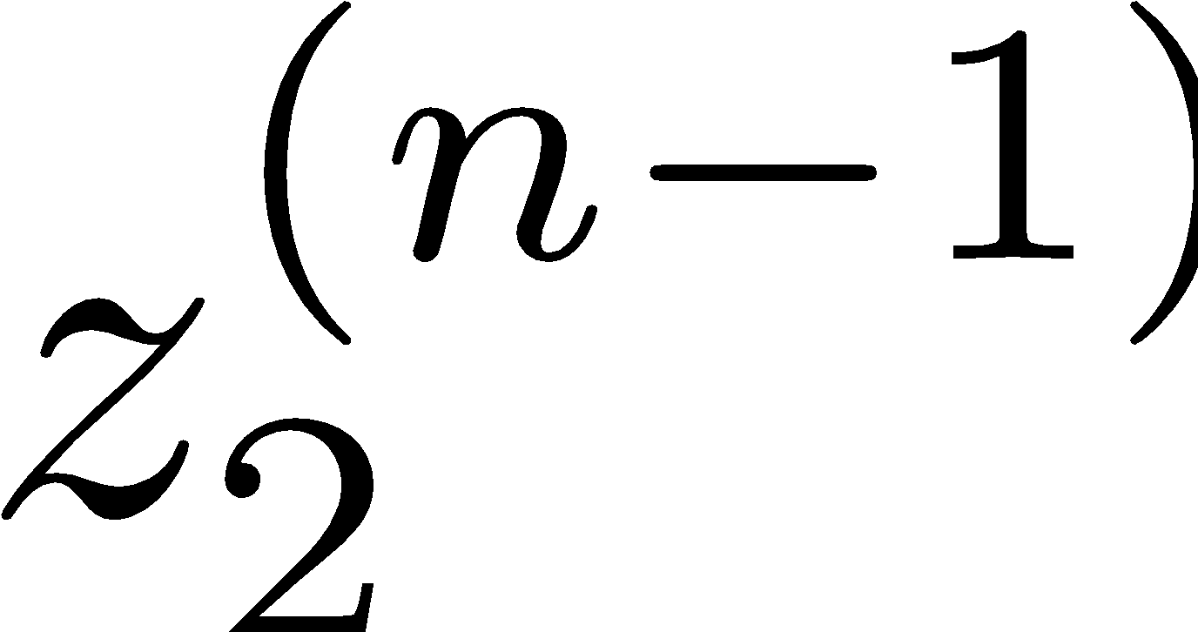
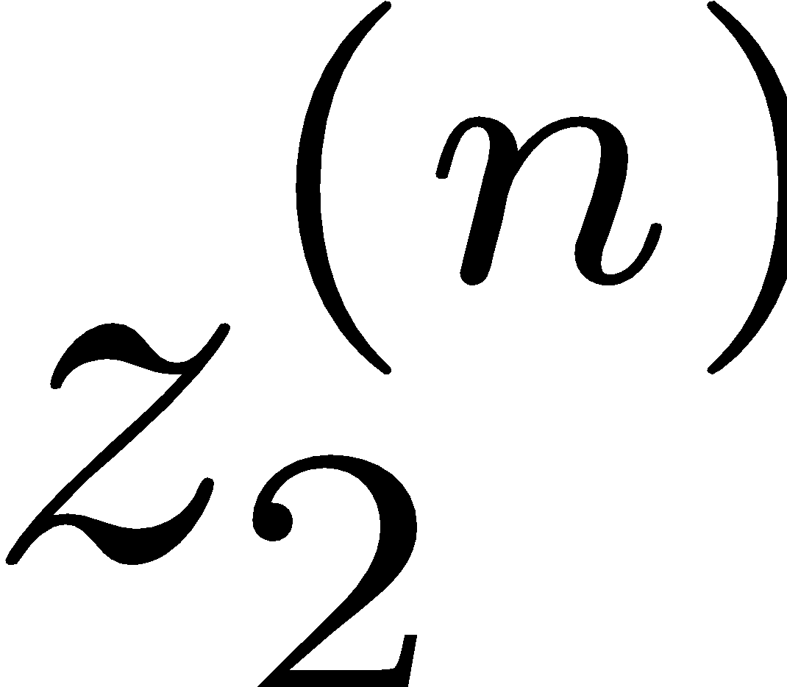
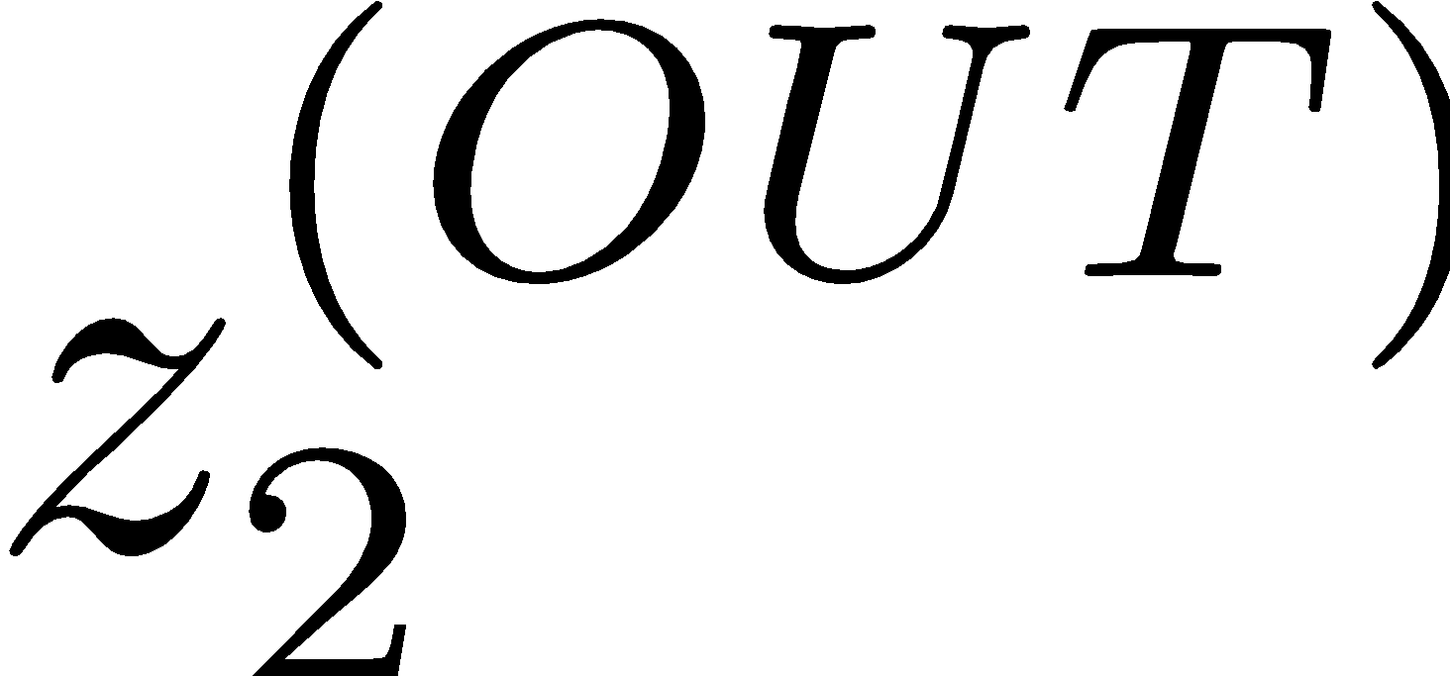
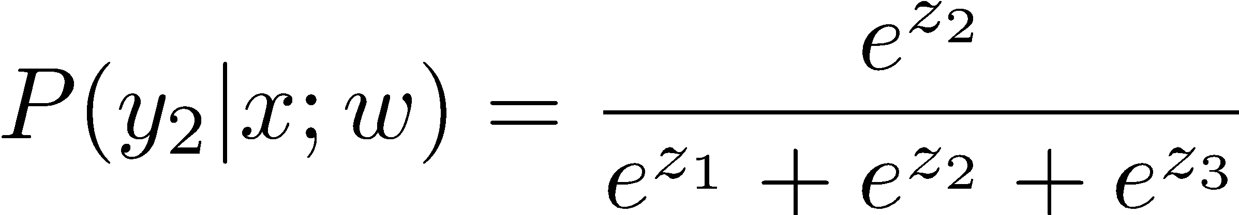
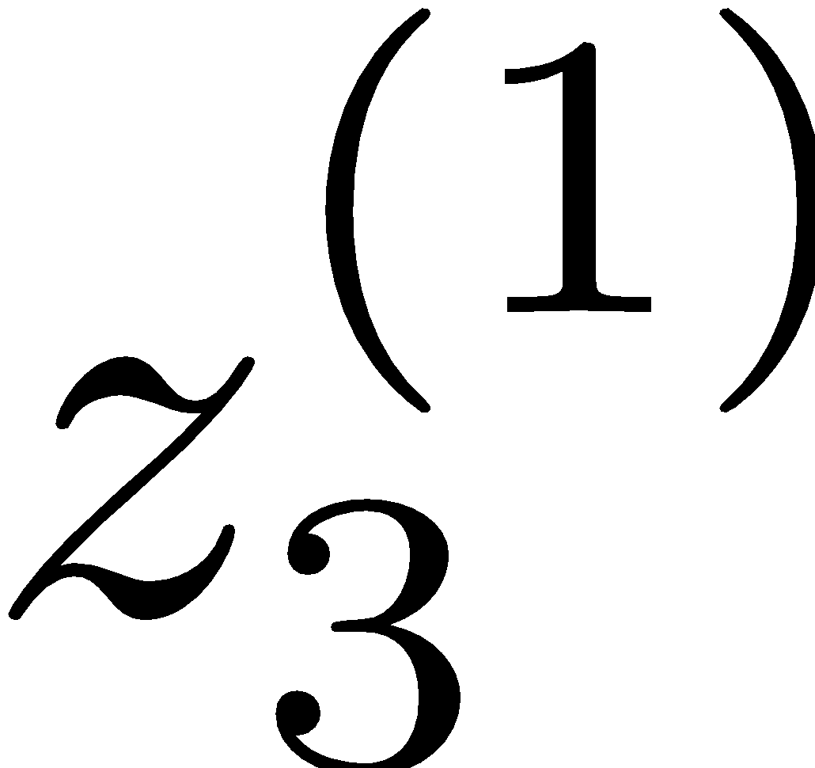
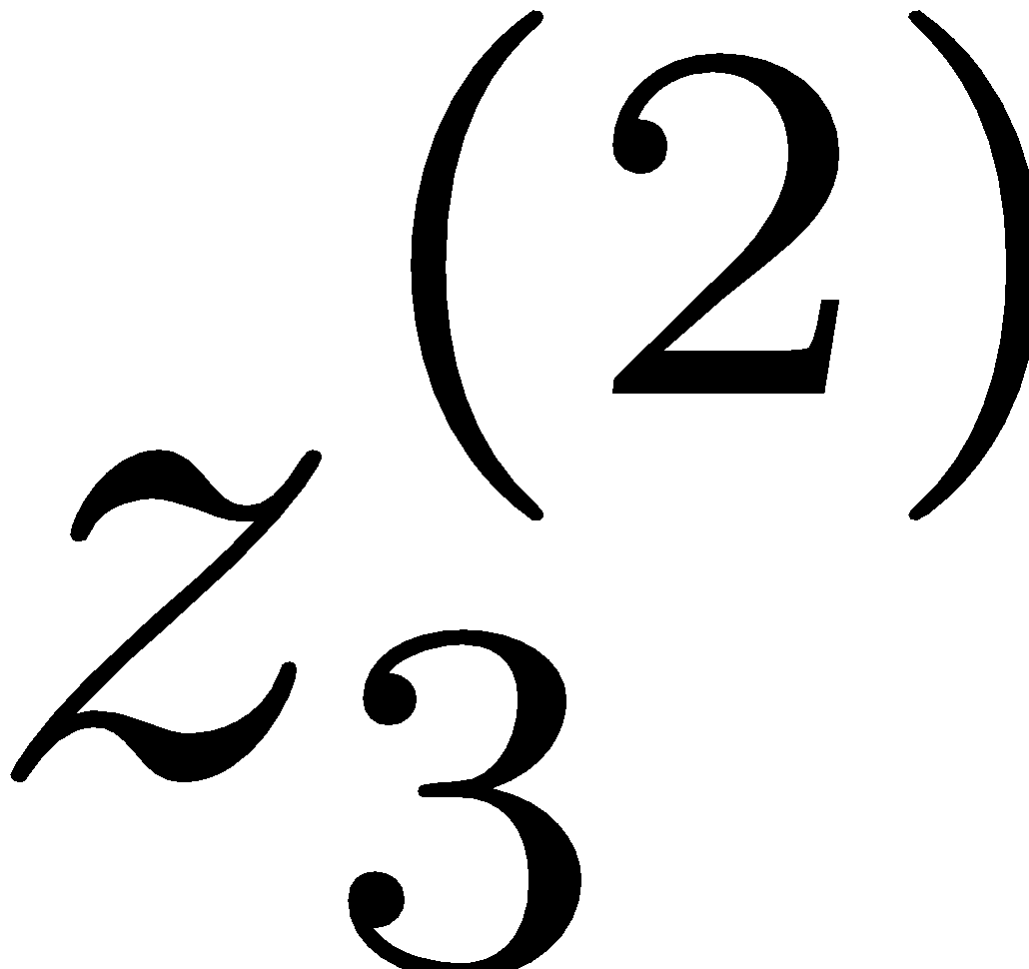
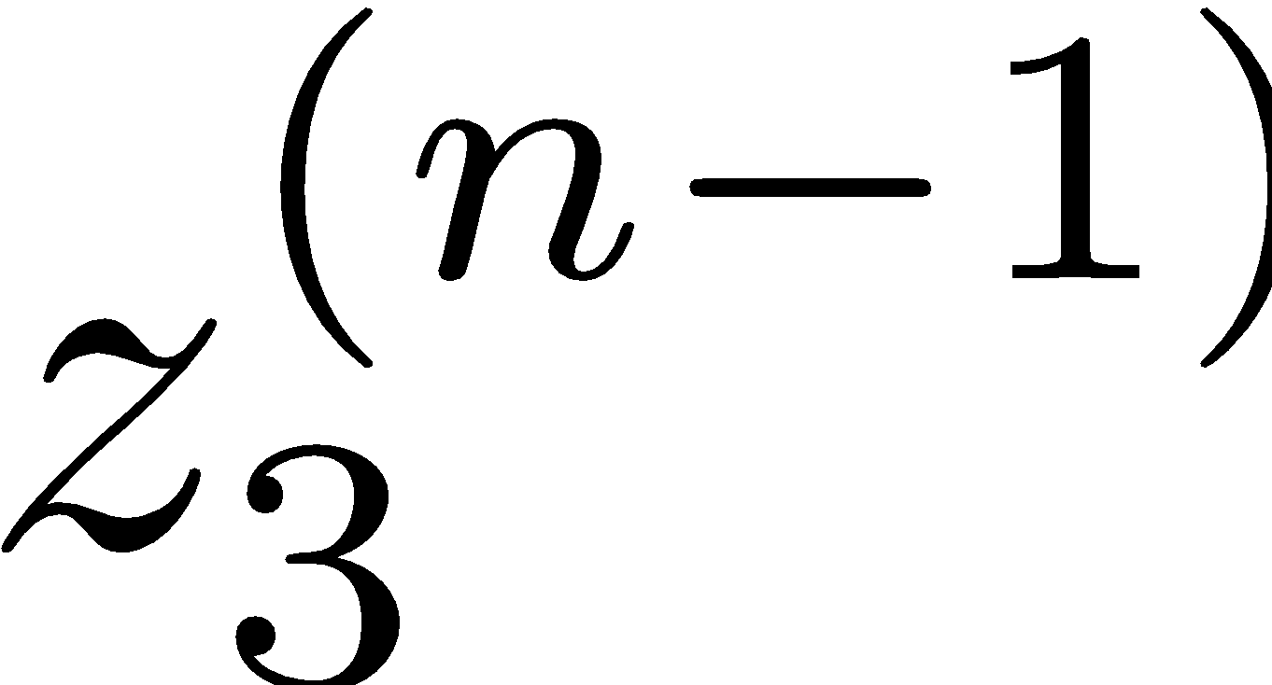
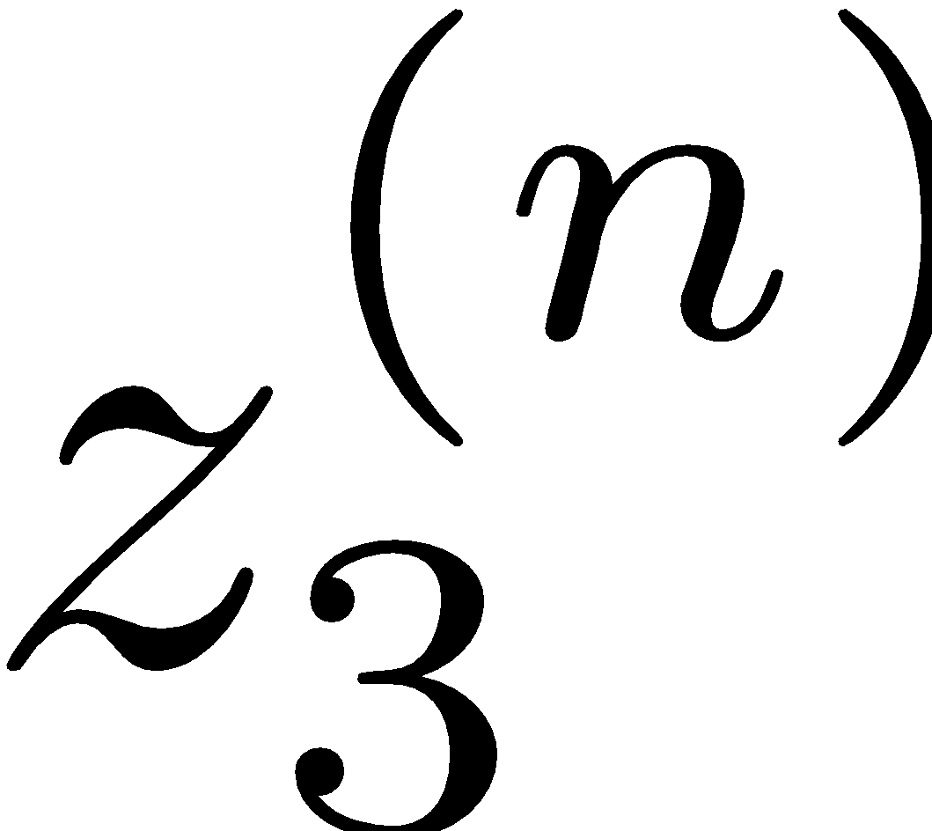
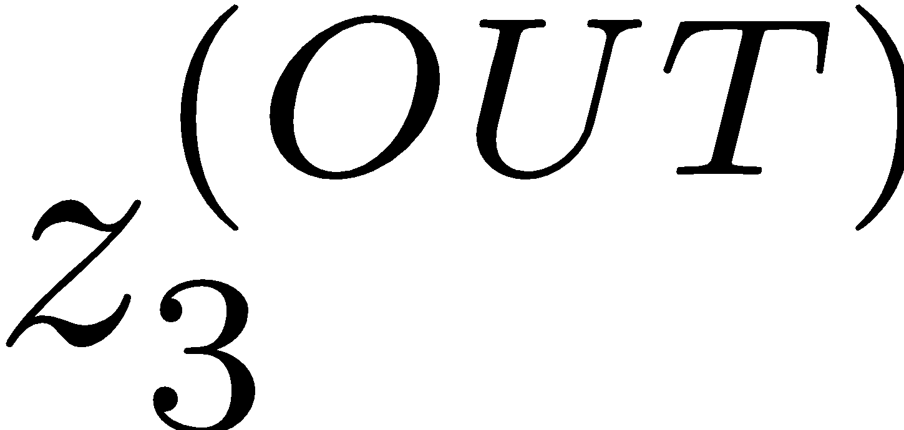
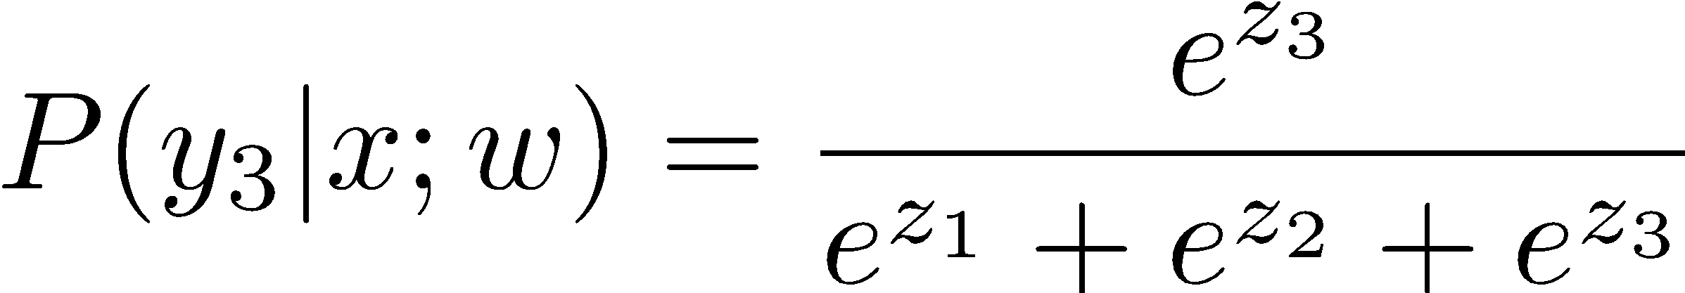
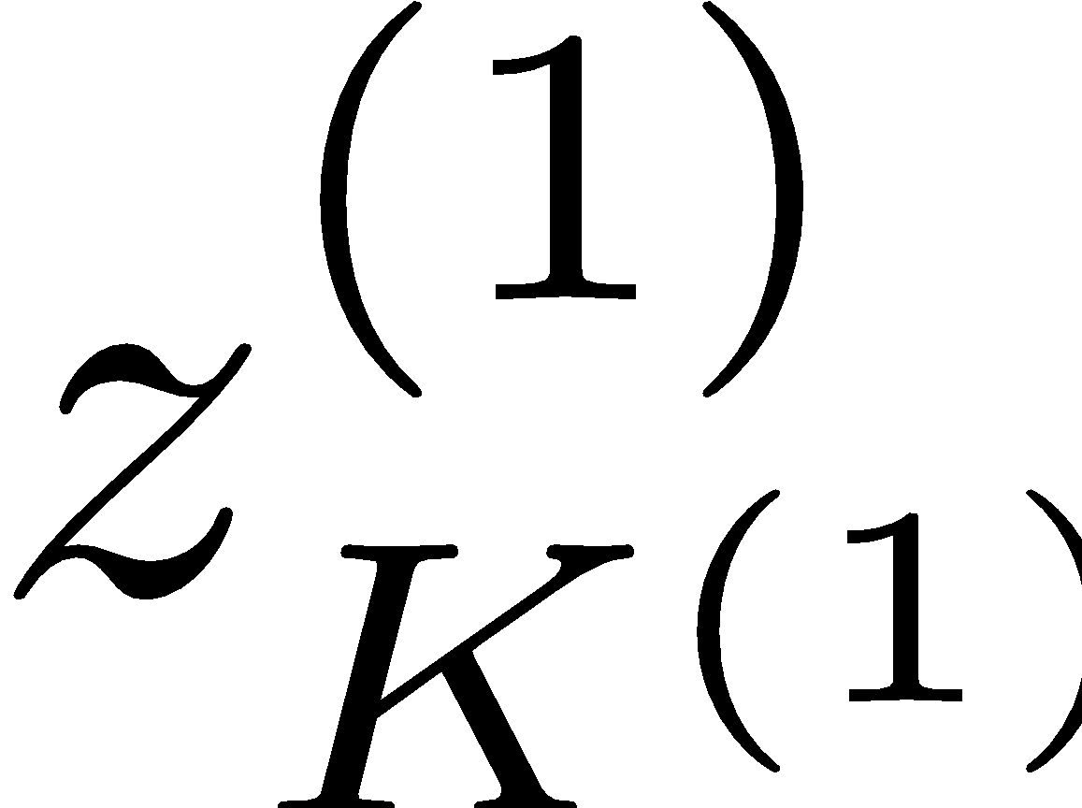
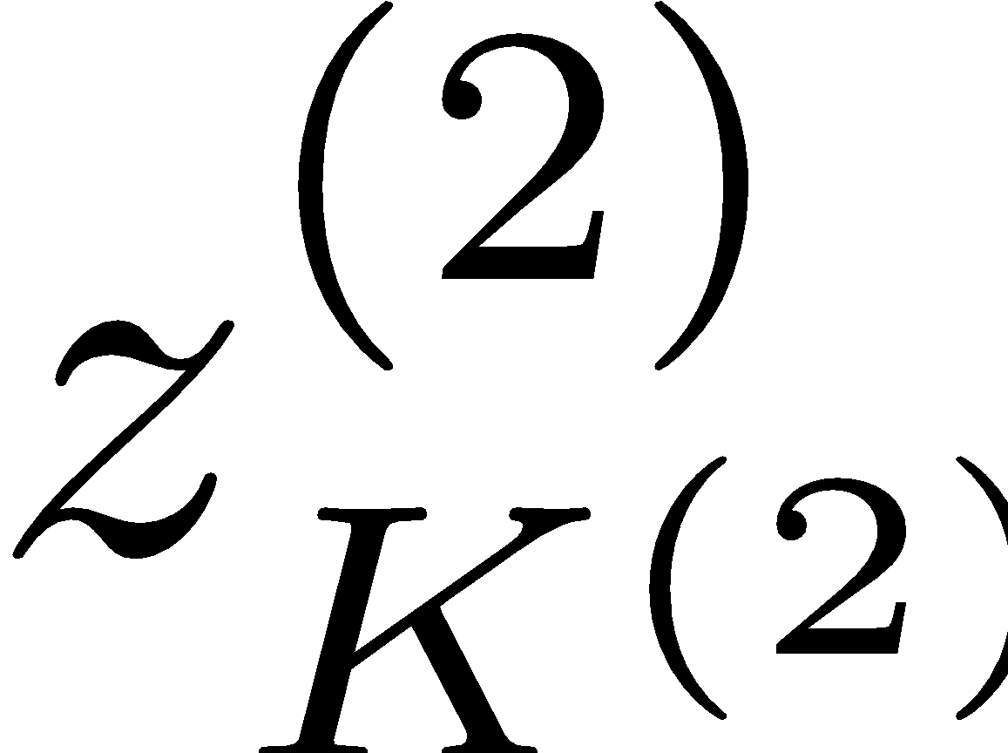
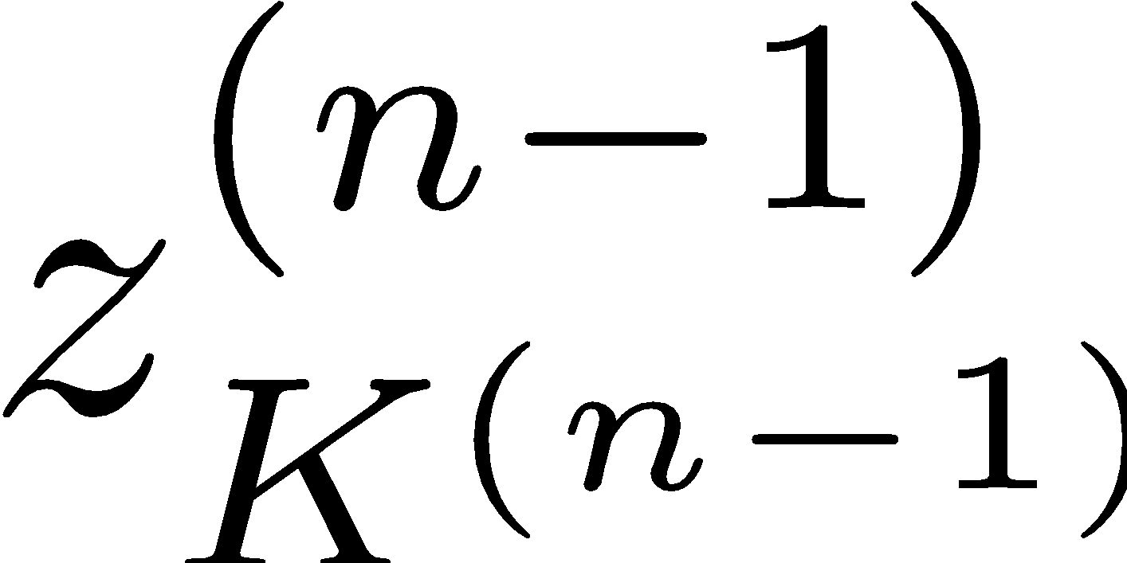
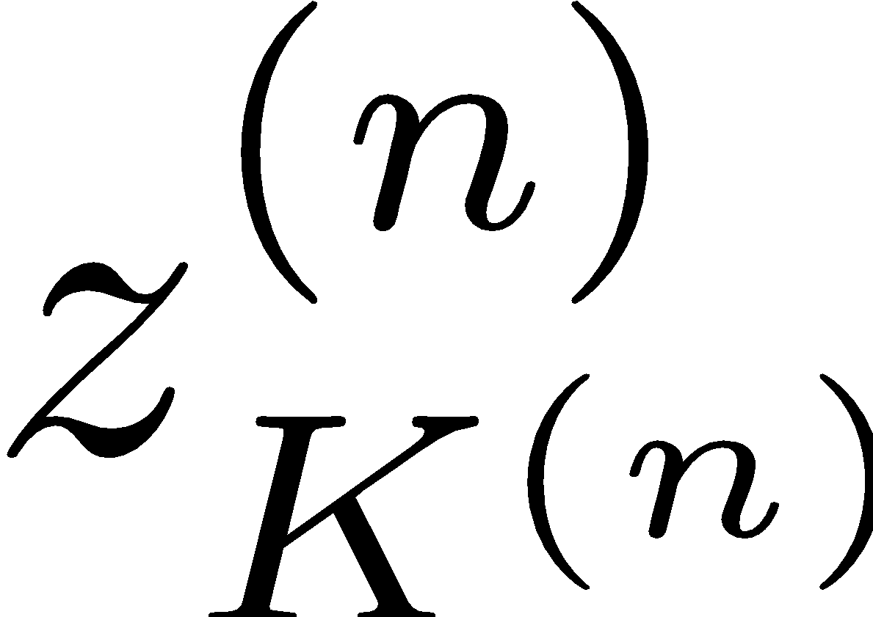
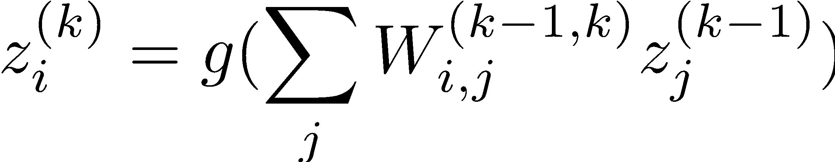
Recap: Neural Networks
x₁
softmax
x₂
…
x₃
…
…
…
…
…
x_{L}
g = nonlinear activation function

Slide 7
Neural Networks Properties
Theorem (Universal Function Approximators). A two-layer neural network with a sufficient number of neurons can approximate any continuous function to any desired accuracy.
Practical considerations
Can be seen as learning the features
Large number of neurons
Danger for overfitting

Slide 8
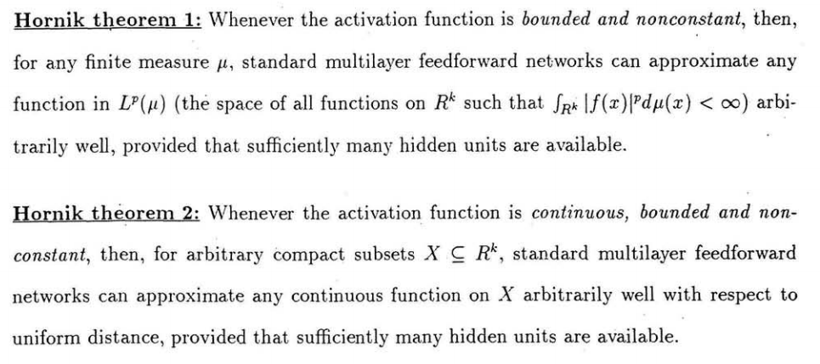
Universal Function Approximation Theorem*
In words: Given any continuous function f(x), if a 2-layer neural network has enough hidden units, then there is a choice of weights that allow it to closely approximate f(x).
Cybenko (1989) “Approximations by superpositions of sigmoidal functions”
Hornik (1991) “Approximation Capabilities of Multilayer Feedforward Networks”
Leshno and Schocken (1991) ”Multilayer Feedforward Networks with Non-Polynomial Activation Functions Can Approximate Any Function”

Slide 9
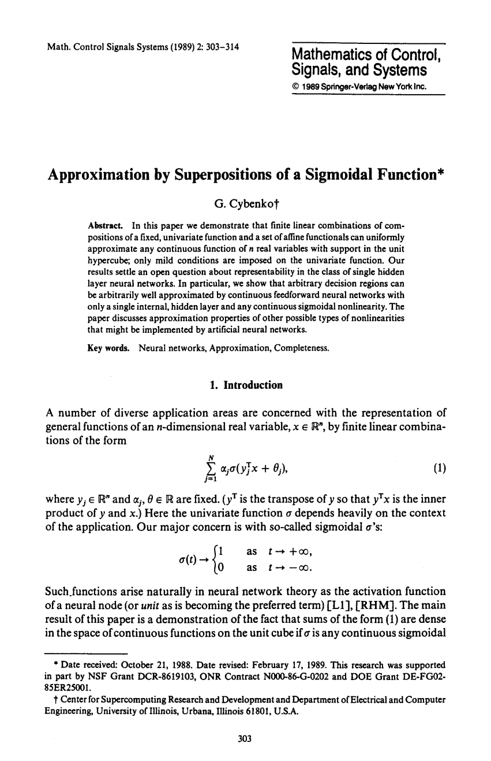
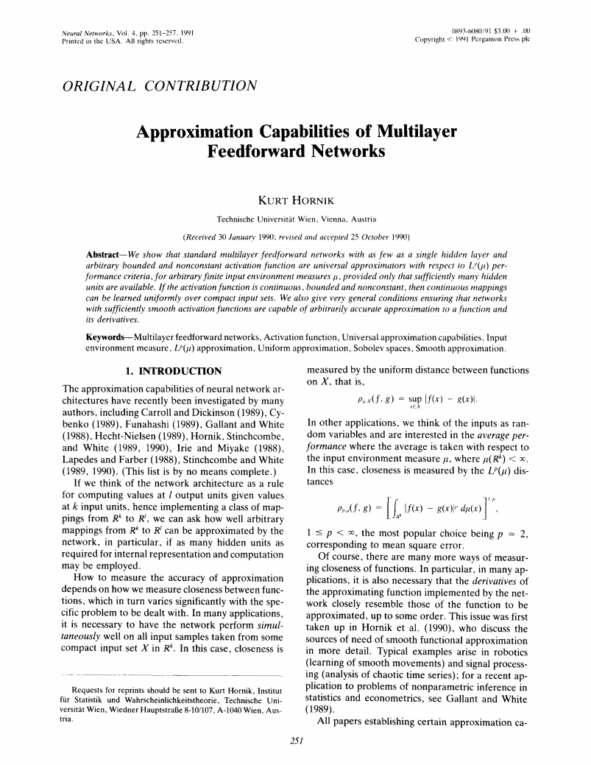
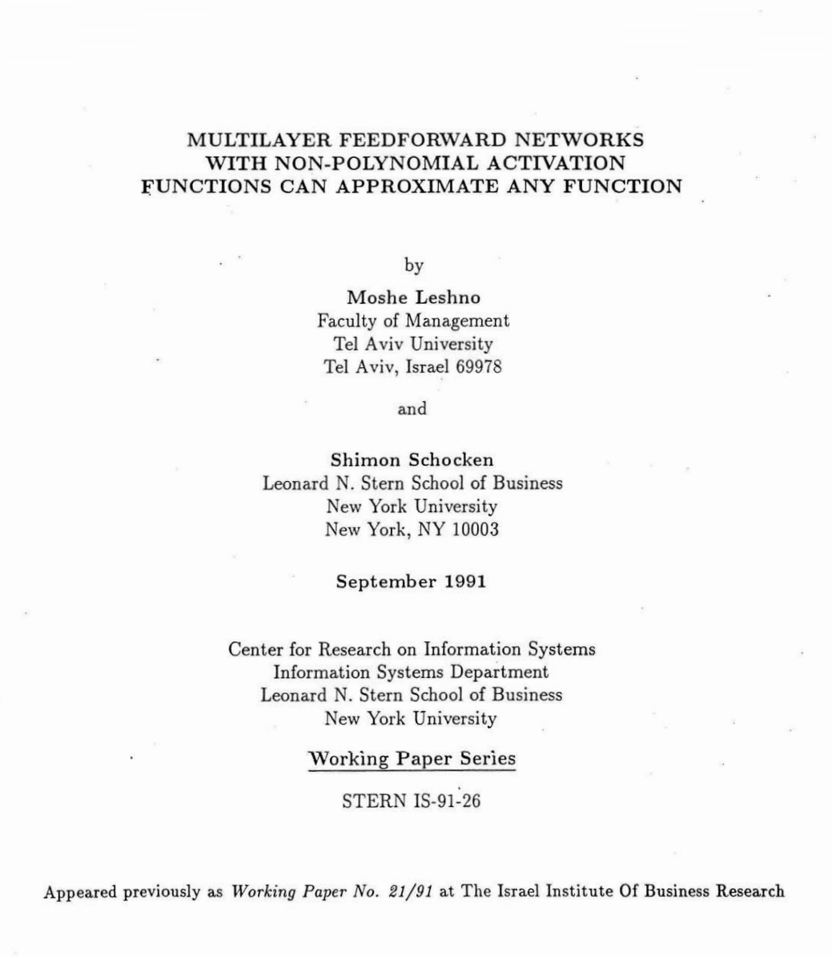
Universal Function Approximation Theorem*
Cybenko (1989) “Approximations by superpositions of sigmoidal functions”
Hornik (1991) “Approximation Capabilities of Multilayer Feedforward Networks”
Leshno and Schocken (1991) ”Multilayer Feedforward Networks with Non-Polynomial Activation Functions Can Approximate Any Function”

Slide 10
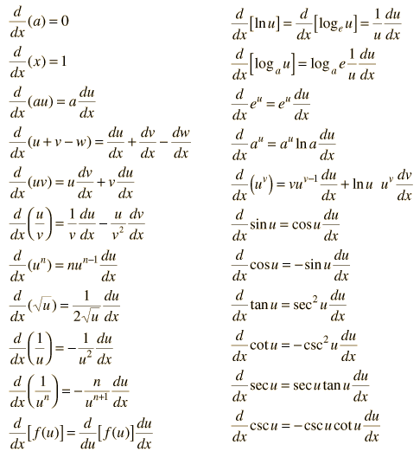
How about computing all the derivatives?
Derivatives tables:
[source: http://hyperphysics.phy-astr.gsu.edu/hbase/Math/derfunc.html

Slide 11
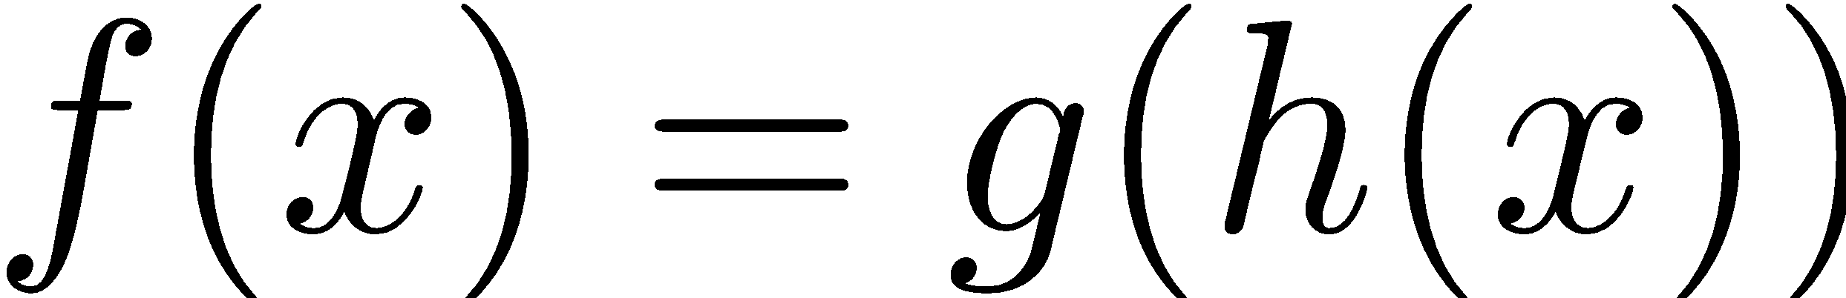
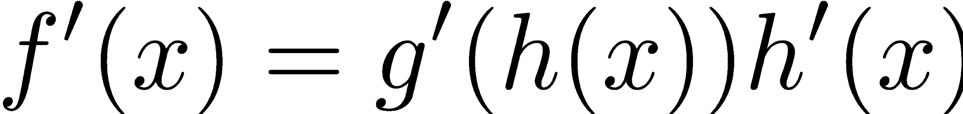
How about computing all the derivatives?
But neural net f is never one of those?
No problem: CHAIN RULE:
If
Then
Derivatives can be computed by following well-defined procedures

Slide 12
Automatic Differentiation
Automatic differentiation software
e.g. Theano, TensorFlow, PyTorch, Chainer
Only need to program the function g(x,y,w)
Can automatically compute all derivatives w.r.t. all entries in w
This is typically done by caching info during forward computation pass of f, and then doing a backward pass = “backpropagation”
Autodiff / Backpropagation can often be done at computational cost comparable to the forward pass
Need to know this exists
How this is done? -- outside of scope of CS188

Slide 13
Training a Network (setting weights)
x₁
softmax
x₂
…
x₃
…
…
…
…
…
x_{L}
g = nonlinear activation function

Slide 14
Training a Network
softmax
Key words:
Forward
Backwards
Gradient
Backprop
…
…
g = nonlinear activation function

Slide 15

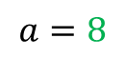


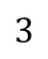
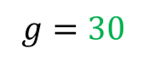

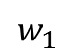

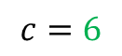
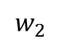
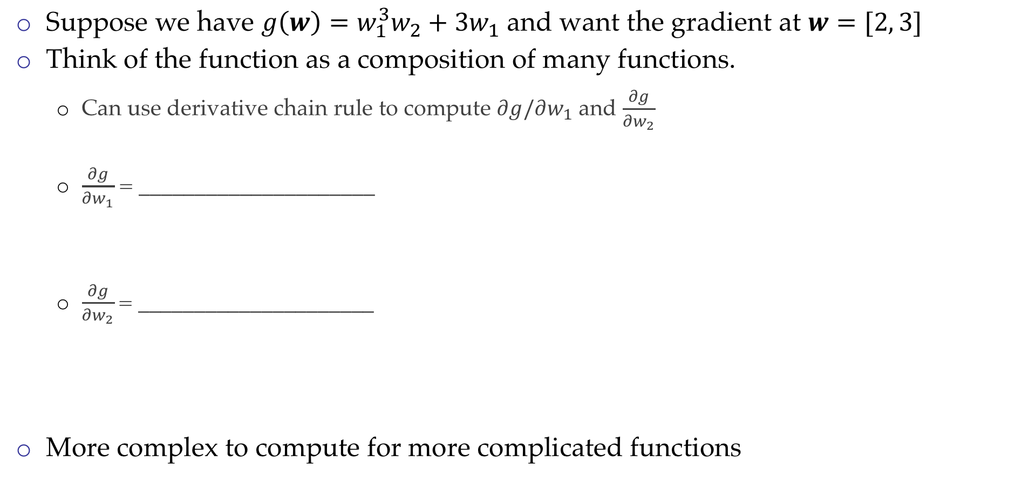
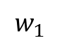
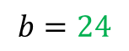
Back Propagation: $g\left(w\right)=w_{1}^{3}w_{2}+3w_{1}$
Suppose we have $g\left(w\right)=w_{1}^{3}w_{2}+3w_{1}$ and want the gradient at $w=[2, 3]$
Think of the function as a composition of many functions.
Can use derivative chain rule to compute $∂g/∂w_{1}$ and $\frac{∂g}{∂w_{2}}$
$\frac{∂g}{∂w_{1}}$ = _____________________
$\frac{∂g}{∂w_{2}}$= _____________________
More complex to compute for more complicated functions
2
$∎^{3}$
$$a=8$$
$$w_{1}$$
$×$
$$b=24$$
$$w_{2}$$
3
$+$
$$g=30$$
$$3$$
$×$
$$c=6$$
$$w_{1}$$
2
Computation Graph

Slide 16

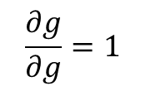



Back Propagation: $g\left(w\right)=w_{1}^{3}w_{2}+3w_{1}$
Suppose we have $g\left(w\right)=w_{1}^{3}w_{2}+3w_{1}$ and want the gradient at $w=[2, 3]$
Think of the function as a composition of many functions.
Can use derivative chain rule to compute $∂g/∂w_{1}$ and $∂g/∂w_{2}$.
$g=b+c$
$\frac{∂g}{∂b}=1$, $\frac{∂g}{∂c}=1$
2
$∎^{3}$
$$a=8$$
$$w_{1}$$
$×$
$$b=24$$
3
$$\frac{∂g}{∂b}=1$$
$$w_{2}$$
$$g=30$$
$+$
$$1$$
$$3$$
$×$
$$c=6$$
$$w_{1}$$
2
$$\frac{∂g}{∂c}=1$$
$$\frac{∂g}{∂g}=1$$
Computation Graph

Slide 17

Back Propagation: $g\left(w\right)=w_{1}^{3}w_{2}+3w_{1}$
Suppose we have $g\left(w\right)=w_{1}^{3}w_{2}+3w_{1}$ and want the gradient at $w=[2, 3]$
Think of the function as a composition of many functions.
Can use derivative chain rule to compute $∂g/∂w_{1}$ and $∂g/∂w_{2}$.
$g=b+c$
$\frac{∂g}{∂b}=1$, $\frac{∂g}{∂c}=1$
$b=a×w_{2}$
$\frac{∂g}{∂a}=\frac{∂g}{∂b}\frac{∂b}{∂a}$
2
$∎^{3}$
$$a=8$$
$$w_{1}$$
$×$
$$b=24$$
3
$$\frac{∂g}{∂b}=1$$
$$w_{2}$$
$$g=30$$
$+$
$$1$$
$$3$$
$×$
$$c=6$$
$$w_{1}$$
2
$$\frac{∂g}{∂c}=1$$
$$\frac{∂g}{∂g}=1$$

Slide 18


Back Propagation: $g\left(w\right)=w_{1}^{3}w_{2}+3w_{1}$
Suppose we have $g\left(w\right)=w_{1}^{3}w_{2}+3w_{1}$ and want the gradient at $w=[2, 3]$
Think of the function as a composition of many functions.
Can use derivative chain rule to compute $∂g/∂w_{1}$ and $∂g/∂w_{2}$.
$g=b+c$
$\frac{∂g}{∂b}=1$, $\frac{∂g}{∂c}=1$
$b=a×w_{2}$
$\frac{∂g}{∂a}=\frac{∂g}{∂b}\frac{∂b}{∂a}=?????$
2
$∎^{3}$
$$a=8$$
$$w_{1}$$
$×$
$$b=24$$
3
$$\frac{∂g}{∂b}=1$$
$$w_{2}$$
$$g=30$$
$+$
$$1$$
$$3$$
$×$
$$c=6$$
$$w_{1}$$
2
$$\frac{∂g}{∂c}=1$$
$$\frac{∂g}{∂g}=1$$

Slide 19


Back Propagation: $g\left(w\right)=w_{1}^{3}w_{2}+3w_{1}$
Suppose we have $g\left(w\right)=w_{1}^{3}w_{2}+3w_{1}$ and want the gradient at $w=[2, 3]$
Think of the function as a composition of many functions.
Can use derivative chain rule to compute $∂g/∂w_{1}$ and $∂g/∂w_{2}$.
$g=b+c$
$\frac{∂g}{∂b}=1$, $\frac{∂g}{∂c}=1$
$b=a×w_{2}$
$\frac{∂g}{∂a}=\frac{∂g}{∂b}\frac{∂b}{∂a}=1\frac{∂b}{∂a}=1⋅3=3$
2
$∎^{3}$
$$a=8$$
$$w_{1}$$
$$3$$
$×$
$$b=24$$
3
$$\frac{∂g}{∂b}=1$$
$$w_{2}$$
$$g=30$$
$+$
$$1$$
$$3$$
$×$
$$c=6$$
$$w_{1}$$
2
$$\frac{∂g}{∂c}=1$$
$$\frac{∂g}{∂g}=1$$

Slide 20

Back Propagation: $g\left(w\right)=w_{1}^{3}w_{2}+3w_{1}$
Suppose we have $g\left(w\right)=w_{1}^{3}w_{2}+3w_{1}$ and want the gradient at $w=[2, 3]$
Think of the function as a composition of many functions.
Can use derivative chain rule to compute $∂g/∂w_{1}$ and $∂g/∂w_{2}$.
$g=b+c$
$\frac{∂g}{∂b}=1$, $\frac{∂g}{∂c}=1$
$b=a×w_{2}$
$\frac{∂g}{∂a}=\frac{∂g}{∂b}\frac{∂b}{∂a}=1\frac{∂b}{∂a}=1⋅3=3$
$a=w_{1}^{3}$
$\frac{∂g}{∂w_{1}}=?????$
2
$∎^{3}$
$$a=8$$
$$w_{1}$$
$$3$$
$×$
$$b=24$$
3
$$\frac{∂g}{∂b}=1$$
$$w_{2}$$
$$g=30$$
$+$
$$1$$
$$3$$
$×$
$$c=6$$
$$w_{1}$$
2
$$\frac{∂g}{∂c}=1$$
$$\frac{∂g}{∂g}=1$$

Slide 21



Back Propagation: $g\left(w\right)=w_{1}^{3}w_{2}+3w_{1}$
Suppose we have $g\left(w\right)=w_{1}^{3}w_{2}+3w_{1}$ and want the gradient at $w=[2, 3]$
Think of the function as a composition of many functions.
Can use derivative chain rule to compute $∂g/∂w_{1}$ and $∂g/∂w_{2}$.
$g=b+c$
$\frac{∂g}{∂b}=1$, $\frac{∂g}{∂c}=1$
$b=a×w_{2}$
$\frac{∂g}{∂a}=\frac{∂g}{∂b}\frac{∂b}{∂a}=1\frac{∂b}{∂a}=1⋅3=3$
$a=w_{1}^{3}$
$\frac{∂g}{∂w_{1}}=\frac{∂g}{∂a}\frac{∂a}{∂w_{1}}=3⋅3w_{1}^{2}=36$
2
$∎^{3}$
$$a=8$$
$$w_{1}$$
$$36$$
$$3$$
$×$
$$b=24$$
3
$$\frac{∂g}{∂b}=1$$
$$w_{2}$$
$$g=30$$
$+$
$$1$$
$$3$$
$×$
$$c=6$$
$$w_{1}$$
2
$$\frac{∂g}{∂c}=1$$
$$\frac{∂g}{∂g}=1$$
Interpretation: A tiny increase in $w_{1}$ will result in an approximately $36$ times increase in g due to this computation path.

Slide 22


Back Propagation: $g\left(w\right)=w_{1}^{3}w_{2}+3w_{1}$
Suppose we have $g\left(w\right)=w_{1}^{3}w_{2}+3w_{1}$ and want the gradient at $w=[2, 3]$
Think of the function as a composition of many functions.
Can use derivative chain rule to compute $∂g/∂w_{1}$ and $∂g/∂w_{2}$.
$g=b+c$
$\frac{∂g}{∂b}=1$, $\frac{∂g}{∂c}=1$
$b=a×w_{2}$
$\frac{∂g}{∂a}=\frac{∂g}{∂b}\frac{∂b}{∂a}=1\frac{∂b}{∂a}=1⋅3=3$
$a=w_{1}^{3}$
$\frac{∂g}{∂w_{1}}=\frac{∂g}{∂a}\frac{∂a}{∂w_{1}}=3⋅3w_{1}^{2}=36$
$\frac{∂g}{∂w_{2}}=???$
2
$∎^{3}$
$$a=8$$
$$w_{1}$$
$$36$$
$$3$$
$×$
$$b=24$$
3
$$\frac{∂g}{∂b}=1$$
$$w_{2}$$
$$g=30$$
$+$
$$1$$
$$3$$
$×$
$$c=6$$
$$w_{1}$$
2
$$\frac{∂g}{∂c}=1$$
$$\frac{∂g}{∂g}=1$$
Hint: $b=a×3$ may be useful.

Slide 23


Back Propagation: $g\left(w\right)=w_{1}^{3}w_{2}+3w_{1}$
Suppose we have $g\left(w\right)=w_{1}^{3}w_{2}+3w_{1}$ and want the gradient at $w=[2, 3]$
Think of the function as a composition of many functions.
Can use derivative chain rule to compute $∂g/∂w_{1}$ and $∂g/∂w_{2}$.
$g=b+c$
$\frac{∂g}{∂b}=1$, $\frac{∂g}{∂c}=1$
$b=a×w_{2}$
$\frac{∂g}{∂a}=\frac{∂g}{∂b}\frac{∂b}{∂a}=1\frac{∂b}{∂a}=1⋅3=3$
$\frac{∂g}{∂w_{2}}=\frac{∂g}{∂b}\frac{∂b}{∂w_{2}}=1\frac{∂b}{∂w_{2}}=1⋅8=8$
$a=w_{1}^{3}$
$\frac{∂g}{∂w_{1}}=\frac{∂g}{∂a}\frac{∂a}{∂w_{1}}=3⋅3w_{1}^{2}=36$
2
$∎^{3}$
$$a=8$$
$$w_{1}$$
$$36$$
$$3$$
$×$
$$b=24$$
3
$$\frac{∂g}{∂b}=1$$
$$w_{2}$$
$$g=30$$
$$8$$
$+$
$$1$$
$$3$$
$×$
$$c=6$$
$$w_{1}$$
2
$$\frac{∂g}{∂c}=1$$
$$\frac{∂g}{∂g}=1$$

Slide 24


Back Propagation: $g\left(w\right)=w_{1}^{3}w_{2}+3w_{1}$
Suppose we have $g\left(w\right)=w_{1}^{3}w_{2}+3w_{1}$ and want the gradient at $w=[2, 3]$
Think of the function as a composition of many functions, use chain rule.
$g=b+c$
$\frac{∂g}{∂b}=1$, $\frac{∂g}{∂c}=1$
$b=a×w_{2}$
$\frac{∂g}{∂a}=\frac{∂g}{∂b}\frac{∂b}{∂a}=1\frac{∂b}{∂a}=1⋅3=3$
$\frac{∂g}{∂w_{2}}=\frac{∂g}{∂b}\frac{∂b}{∂w_{2}}=1\frac{∂b}{∂w_{2}}=1⋅8=8$
$a=w_{1}^{3}$
$\frac{∂g}{∂w_{1}}=\frac{∂g}{∂a}\frac{∂a}{∂w_{1}}=3⋅3w_{1}^{2}=36$
$c=3w_{1}$
$\frac{∂g}{∂w_{1}}=\frac{∂g}{∂c}\frac{∂c}{∂w_{1}}=1⋅3=3$
2
$∎^{3}$
$$a=8$$
$$w_{1}$$
$$36$$
$$3$$
$×$
$$b=24$$
3
$$\frac{∂g}{∂b}=1$$
$$w_{2}$$
$$g=30$$
$$8$$
$+$
$$1$$
$$3$$
$×$
$$c=6$$
$$w_{1}$$
2
$$3$$
$$\frac{∂g}{∂c}=1$$
$$\frac{∂g}{∂g}=1$$
Adding the changes to g contributed by
change in w₁ together

Slide 25

Back Propagation: $g\left(w\right)=w_{1}^{3}w_{2}+3w_{1}$
Suppose we have $g\left(w\right)=w_{1}^{3}w_{2}+3w_{1}$ and want the gradient at $w=[2, 3]$
Think of the function as a composition of many functions, use chain rule.
$g=b+c$
$\frac{∂g}{∂b}=1$, $\frac{∂g}{∂c}=1$
$b=a×w_{2}$
$\frac{∂g}{∂a}=\frac{∂g}{∂b}\frac{∂b}{∂a}=1\frac{∂b}{∂a}=1⋅3=3$
$\frac{∂g}{∂w_{2}}=\frac{∂g}{∂b}\frac{∂b}{∂w_{2}}=1\frac{∂b}{∂w_{2}}=1⋅8=8$
$a=w_{1}^{3}$
$\frac{∂g}{∂w_{1}}=\frac{∂g}{∂a}\frac{∂a}{∂w_{1}}=3⋅3w_{1}^{2}=36$
$c=3w_{1}$
$\frac{∂g}{∂w_{1}}=\frac{∂g}{∂c}\frac{∂c}{∂w_{1}}=1⋅3=3$
2
$∎^{3}$
$$a=8$$
$$w_{1}$$
$$36$$
$$3$$
$×$
$$b=24$$
3
$$\frac{∂g}{∂b}=1$$
$$w_{2}$$
$$g=30$$
$$8$$
$+$
$$1$$
$$3$$
$×$
$$c=6$$
$$w_{1}$$
2
$$3$$
$$\frac{∂g}{∂c}=1$$
$$\frac{∂g}{∂g}=1$$
$$∇g=\left[\frac{∂g}{∂w_{1}},\frac{∂g}{∂w_{2}}\right]=[39, 8]$$

Slide 26


Slide 27


Slide 28
Summary of Key Ideas
Optimize probability of label given input
Continuous optimization
Gradient ascent:
Compute steepest uphill direction = gradient (= just vector of partial derivatives)
Take step in the gradient direction
Repeat
Deep neural nets
Layered computation graph
Last layer = often logistic regression
Now also many more layers before this last layer
= computing the features
the features are learned rather than hand-designed
Different neural network architectures: CNN, RNN, LSTM, Transformer
Universal function approximation theorem
If neural net is large enough
Then neural net can represent any continuous mapping from input to output with arbitrary accuracy
But remember: need to avoid overfitting / memorizing the training data; early stopping!
Automatic differentiation gives the derivatives efficiently

Slide 29

Different Neural Network Architectures
Neural network as
General computation graph
Krizhevsky, Suskever, Hinton, 2012

Slide 30
Different Neural Network Architectures
Exploration of different neural network architectures
ResNet: residual networks
Networks with attention
Transformer networks
Neural network architecture search
Really large models
GPT2, GPT3
CLIP

Slide 31


Slide 32



